Slide 1

Green Pace
Security Policy Presentation
Developer: Jacob Burchett

Slide 2

OVERVIEW: DEFENSE IN DEPTH
The purpose of this security policy is to define security principles and standards in order to provide an understanding of security and vulnerabilities.

Slide 3
THREATS MATRIX
Threats are generally categorized based on likelihood, severity, and cost. The threat matrix can be used to determine the level of threat.
Likely Threats of this type are more frequent | Priority Threats of this type are potentially debilitating and need to be addressed immediately
Low priority Threats of this type are less impactful compared to the cost of remediation | Unlikely Threats of this type occur less frequently

Slide 4
10 PRINCIPLES
Validate Input Data
Heed Compiler Warnings
Architect and Design for Security Policies
Keep It Simple
Default Deny
Adhere to the Principle of Least Privilege
Sanitize Data Sent to Other Systems
Practice Defense in Depth
Use Effective Quality Assurance Techniques
Adopt a Secure Coding Standard

Slide 5
CODING STANDARDS
Data Type
Never qualify a reference type with const or volatile
Severity: Low
Data Value
Do not depend on the order of evaluation for side effects
Severity: Medium
String Correctness
Guarantee that storage for strings has sufficient space for character data and the null terminator
Severity: High
SQL Injection
Prevent SQL injection
Severity: High
Memory Protection
Properly deallocate dynamically allocated resources
Severity: High
Assertions
Use a static assertion to test the value of a constant expression
Severity: Low
Exceptions
Handle all exceptions
Severity: Low
Object Oriented Programming
Do not invoke virtual functions from constructors or destructors
Severity: Low
Concurrency
Ensure actively held locks are released on exceptional conditions
Severity: Low
Input Output
Close files when they are no longer needed
Severity: Medium

Slide 6
ENCRYPTION POLICIES
Encryption at Rest
Refers to the process of scrambling data for the purpose of only allowing access with a key.
Reduces the risk of access by unauthorized individuals
Encryption in Flight
The process of securing data that is being transmitted over a network
Essential in the prevention of data leaks and interceptions
Encryption in Use
Refers to the process of securing sensitive data while being accessed by a system
Ensures that even if unwanted access is obtained, the receiver only receives encrypted data

Slide 7
TRIPLE-A POLICIES
Authentication
Refers to the process of verifying the identity of the individual or system attempting to gain access
Essential in ensuring unwanted access is not obtained
Authorization
Refers to the level of access an individual or system has once authentication has taken place
Ensures that individuals and systems with access are not able to view or modify data that is not essential to their tasks
Accounting
Refers to the process of keeping a log of activities and events taking place within a system
Provides an accurate detailing of actions as a means of identifying potential issues

Slide 8
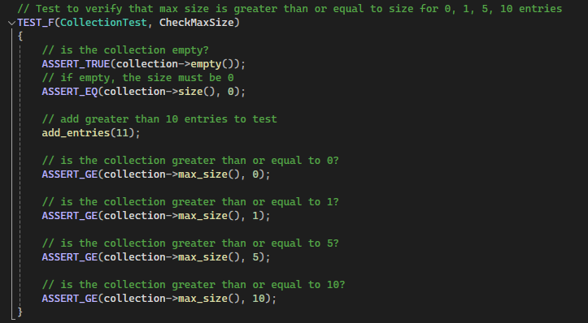
Unit Testing Max Size

Slide 9
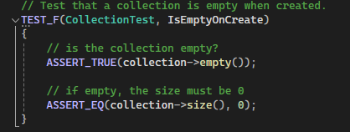
Unit Testing Is Empty

Slide 10
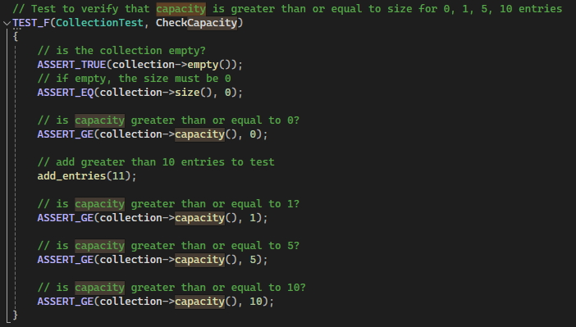
Unit Testing Capacity

Slide 11
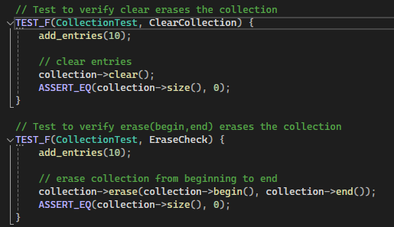
Unit Testing Erase

Slide 12

AUTOMATION SUMMARY

Slide 13
TOOLS
The DevSecOps pipeline is an automated workflow cycle that incorporates security practices throughout the software development lifecycle to include pre and post deployment of the system.
There are a multitude of external tools for use with a DevSecOps pipeline.
CodeSonar
Enables the analysis of complete applications
Helix QAC
Used when developing software in safety-critical industries like healthcare
Parasoft C/C++test
Used when developing C or C++ software where comprehensive testing is required
Particularly used for security-sensitive software
Klocwork
Used to analyze source code in real time
Simplifies peer code reviews

Slide 14
RISKS AND BENEFITS
Pros:
Enables a focus on security immediately when beginning development
A more effective approach can be taken
Simplifies the incorporation of security due to the early focus
Cons:
Higher upfront cost
Higher development level
Increased complexity
While the upfront cost of incorporating security measures at the beginning of development may deter some, a system developed in this way is overall cheaper and more stable than one without. Adding additional security measures later will almost always be more time consuming and costly than early incorporation.

Slide 15
RECOMMENDATIONS
Gaps:
Resource Allocation
Proper resource allocation is necessary for effective development
Real-time Monitoring
Real-time monitoring greatly reduces the risk of attack and significantly increases response time when an attack occurs
Thorough Incorporation of Security
Incorporation of security throughout development reduces overall cost and time as well as simplifies development for ease of upkeep
Recommendations:
Proper Resource Allocation
Real-time Monitoring Incorporation
Improved Security Incorporation

Slide 16
CONCLUSIONS
Throughout this presentation we have discussed the principles and standards that should be adopted for proper development of the system. Through the incorporation of these standards and principles, we can effectively create a system that is secure, functional, and easy to manage long-term.
Principles:
Validate Input Data
Heed Compiler Warnings
Architect and Design for Security Policies
Keep it Simple
Default Deny
Adhere to the Principle of Least Privilege
Sanitize Data Sent to Other Systems
Practice Defense in Depth
Use Effective Quality Assurance Techniques
Adopt a Secure Coding Standard
Standards:
Data Type
Data Value
String Correctness
SQL Injection
Memory Protection
Assertions
Exceptions
Object Oriented Programming
Concurrency
Input Output

Slide 17
REFERENCES
Parasoft. (2024, April 4). Code security testing tools for C and C++. https://www.parasoft.com/products/parasoft-c-ctest/c-c-security-testing/#:~:text=Developers%20use%20Parasoft%20C%2FC,the%20software%20is%20built%20securely.
Perforce. (2025a). The best SAST tool for accelerating time-to-market & delivering quality code. https://www.perforce.com/products/klocwork#:~:text=Use%20Klocwork%20static%20application%20security,to%20internationally%20recognized%20security%20standards.
Perforce. (2025b). When code compliance is critical to your bottom line, trust Helix Qac. https://www.perforce.com/products/helix-qac
Verifysoft Technology. (2025, January 14). CODESONAR - static code analysis when safety and security matter. Verifysoft Technology GmbH. https://www.verifysoft.com/en_codesonar.html#:~:text=CodeSonar%20enables%20teams%20to%20analyze,improves%20quality%2C%20and%20instills%20confidence.

